Slide 1
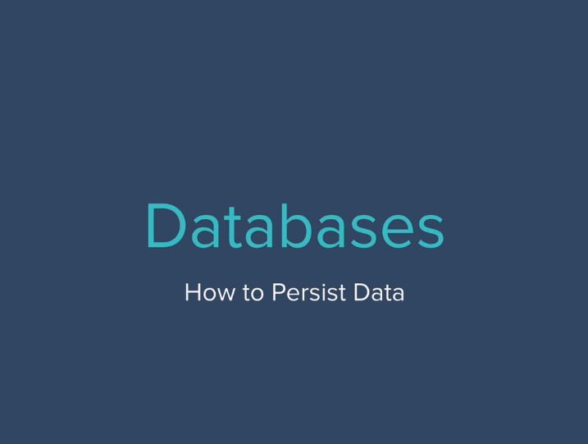

Slide 2


Slide 3
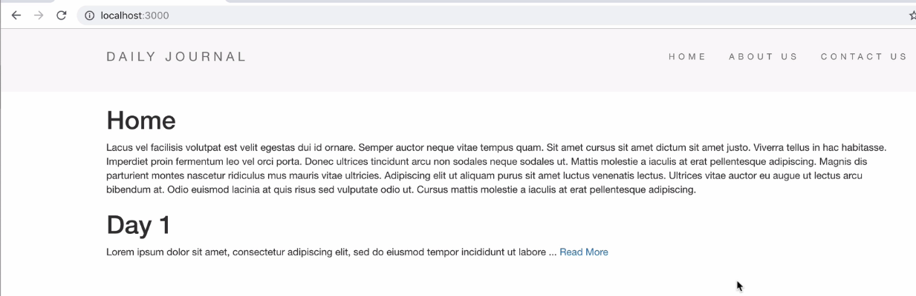

Slide 4
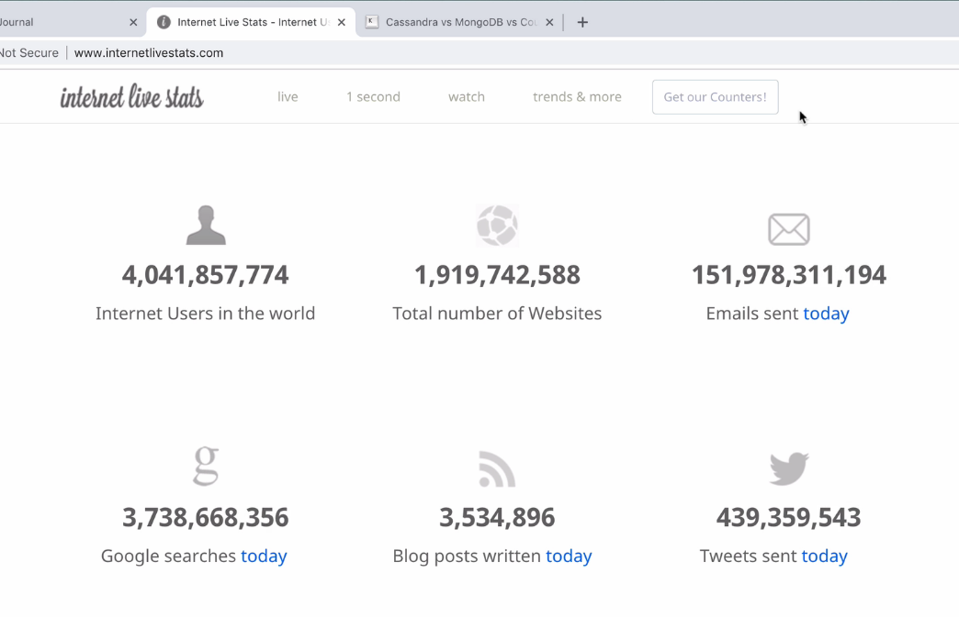

Slide 5

Choosing the right Data base ?

Slide 6
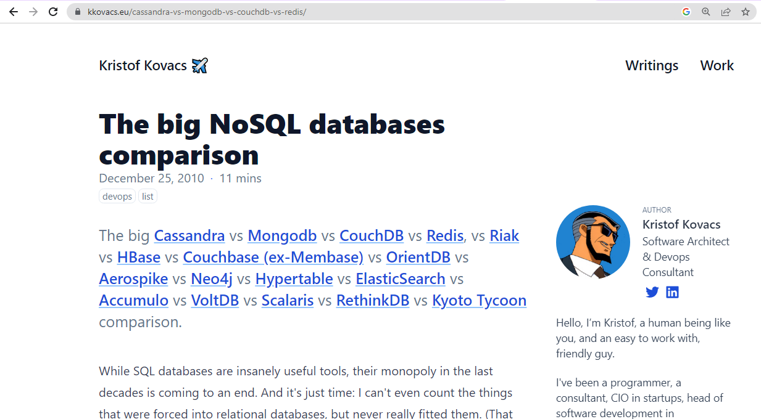
There are lot of Data base are available in market

Slide 7
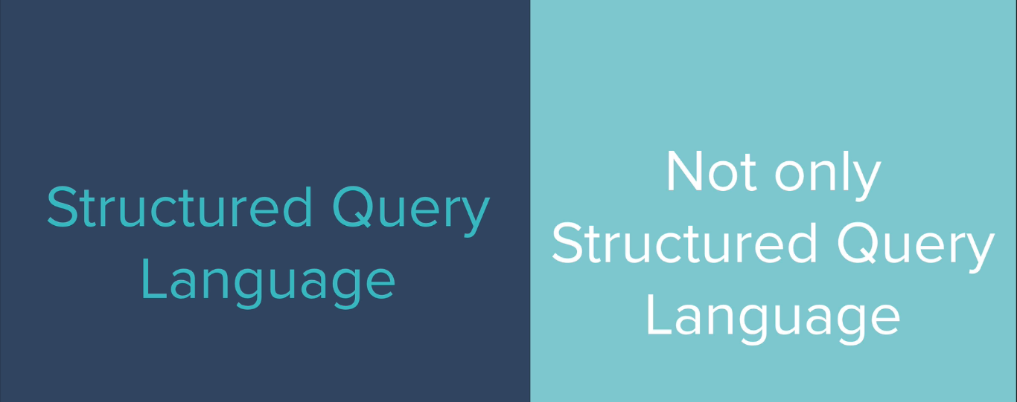

Slide 8
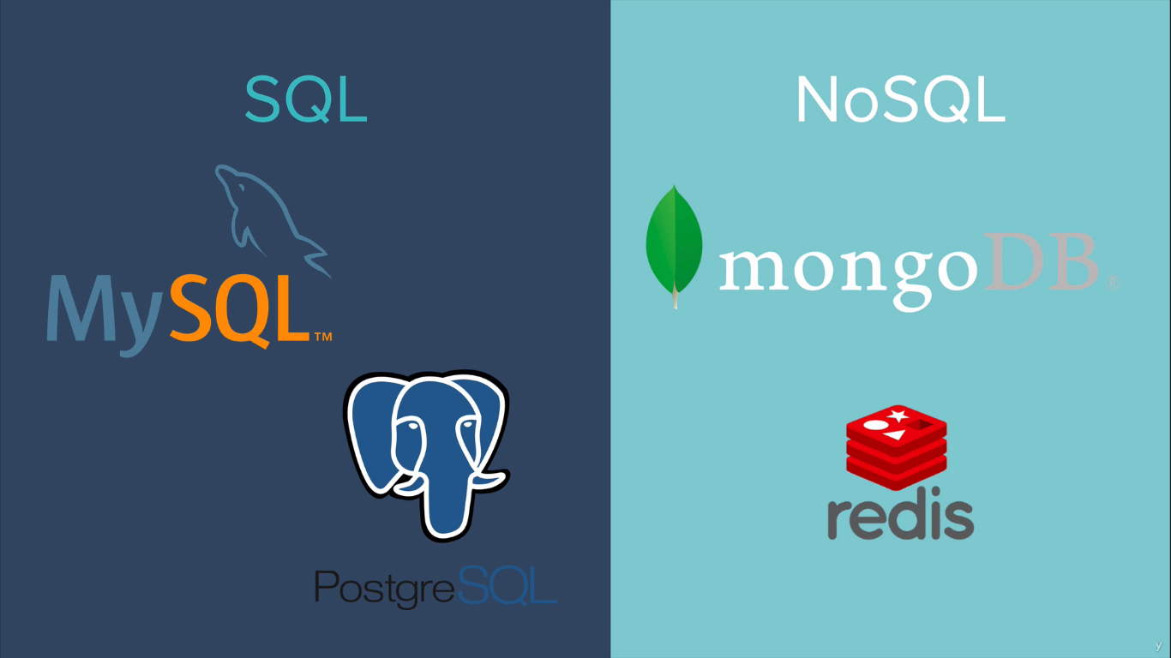

Slide 9


Slide 10


Slide 11
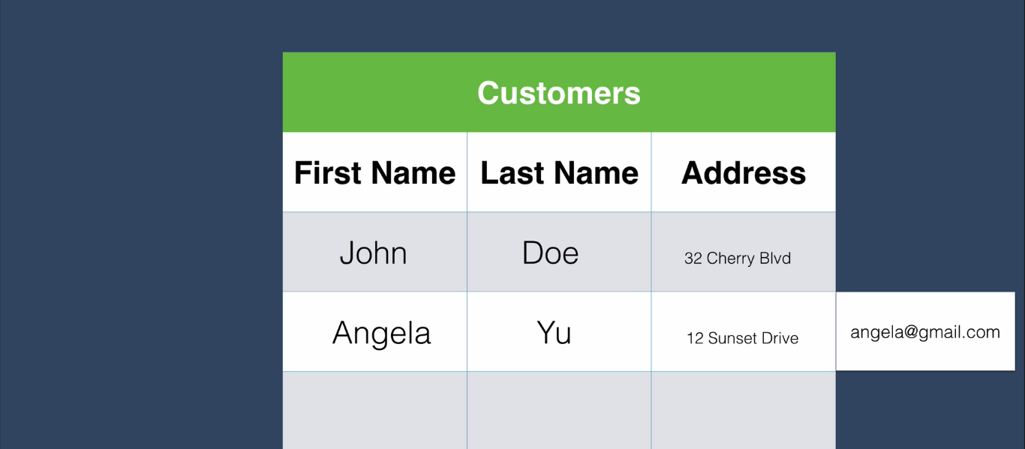
Table format Storage : SQL Data base

Slide 12
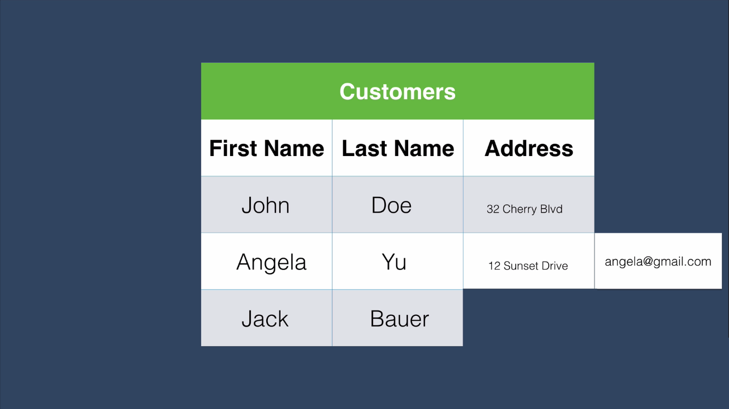
Not Table format Storage : NO SQL Data base

Slide 13
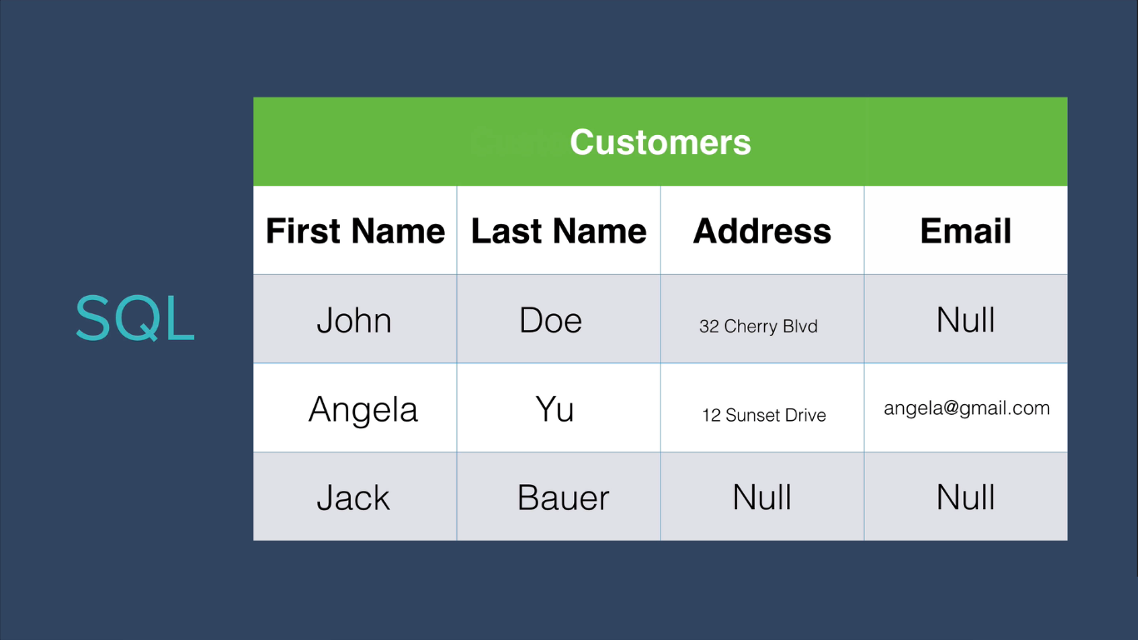

Slide 14
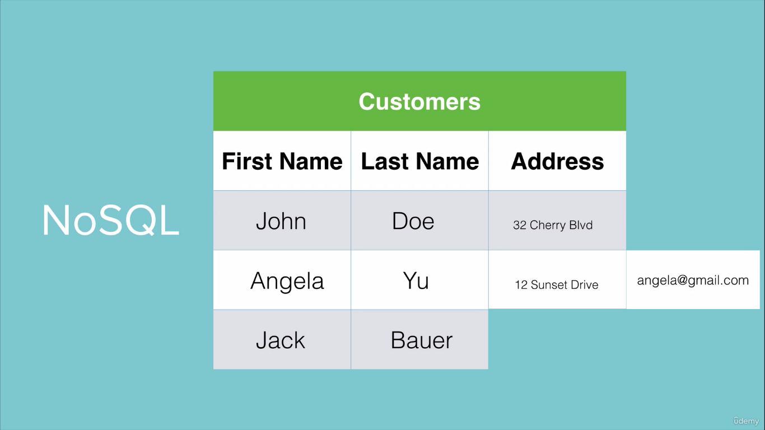

Slide 15


Slide 16
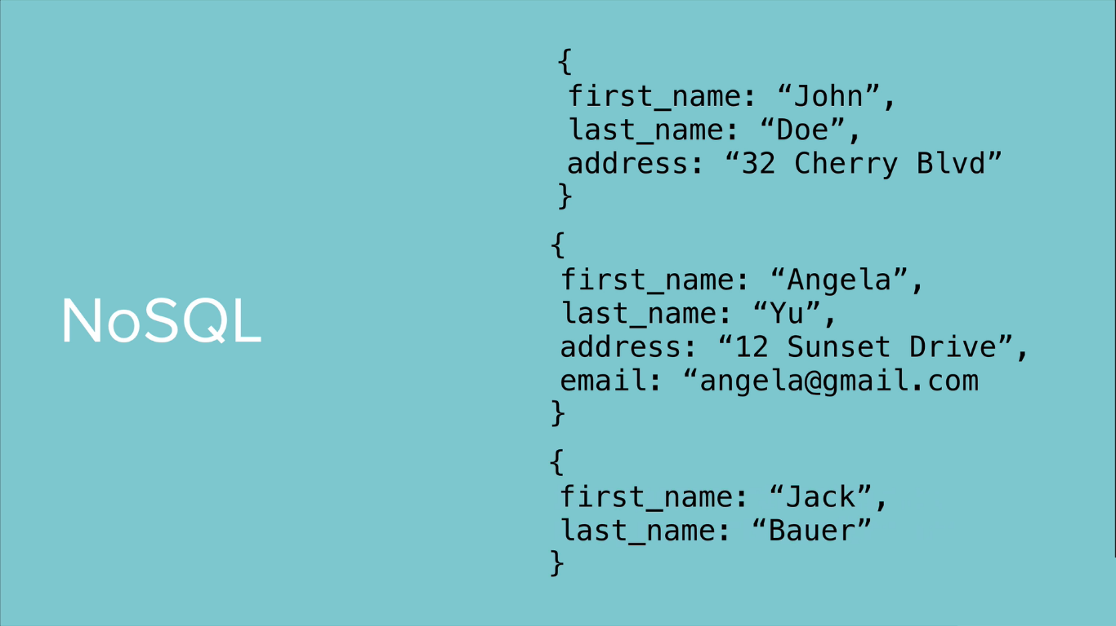

Slide 17


Slide 18
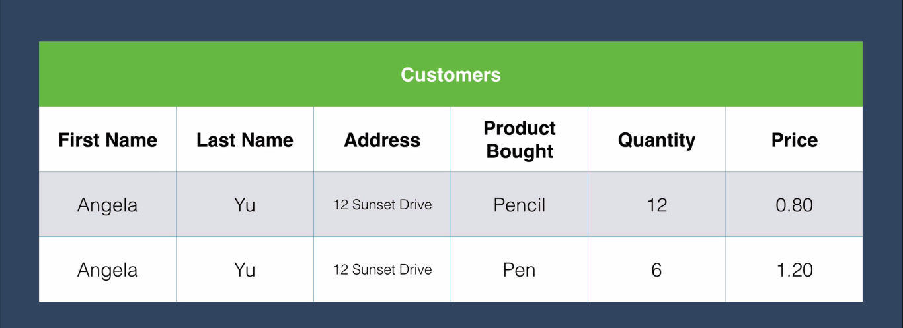

Slide 19
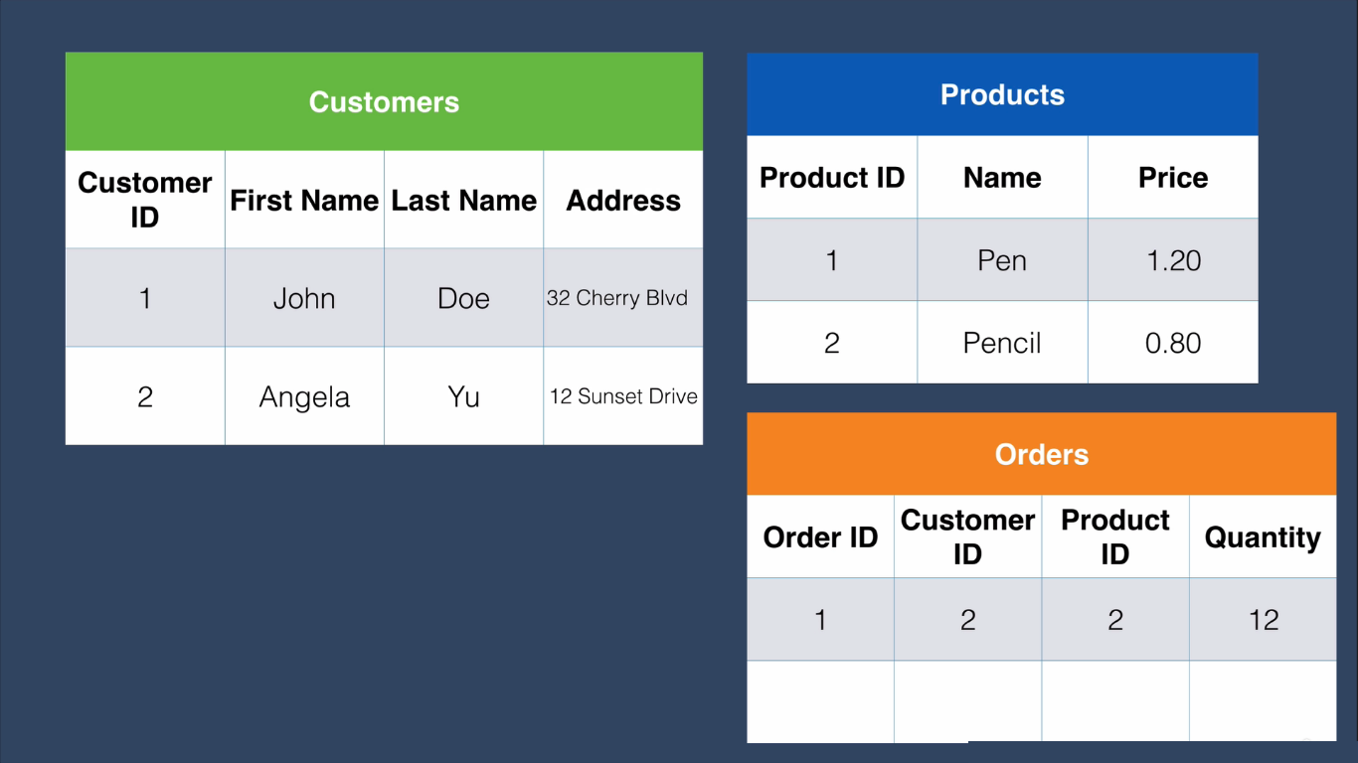
Relationship between tables in SQL

Slide 20
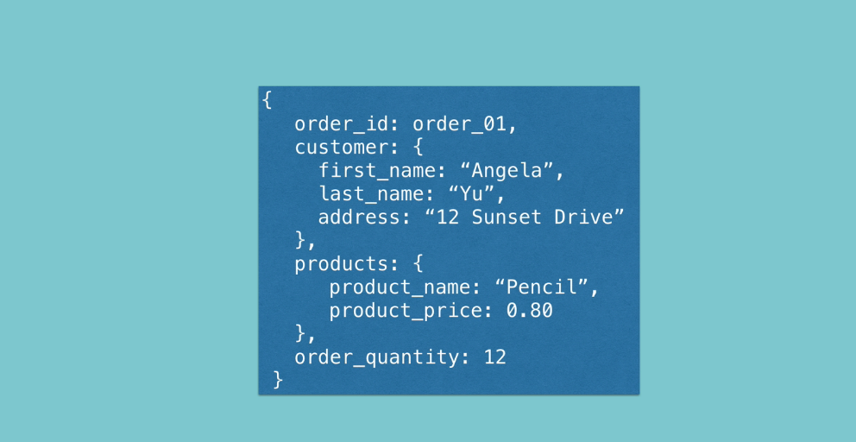
Document Data in NO SQL

Slide 21
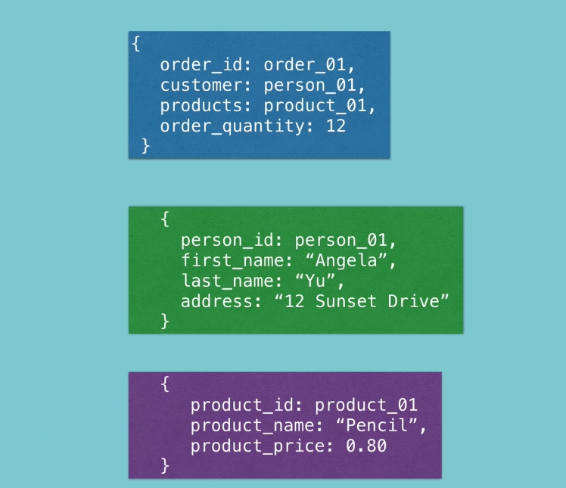
Relationship between documents in NO-SQL

Slide 22

Which one is best ?

Slide 23
As a developer, we have to choose the right Database to our
Application

Slide 24
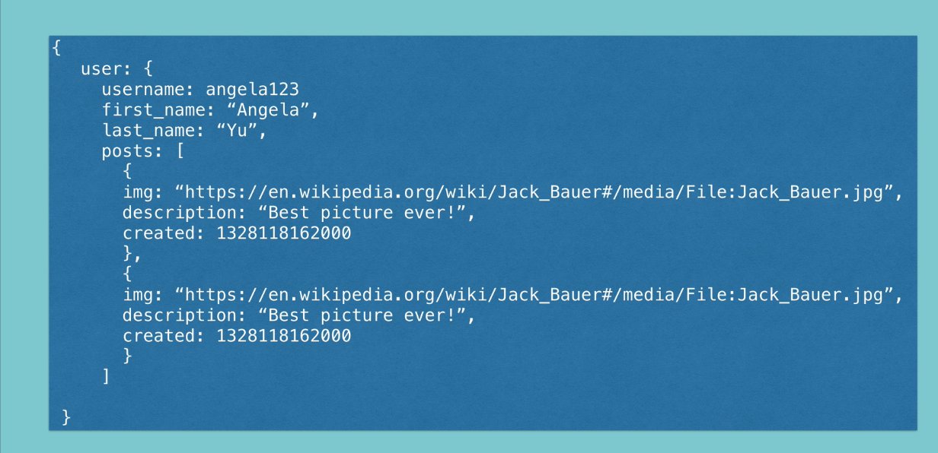
For Example: Instagram data to be stored in NO-SQL

Slide 25

SQL Vs NO SQL

Slide 26
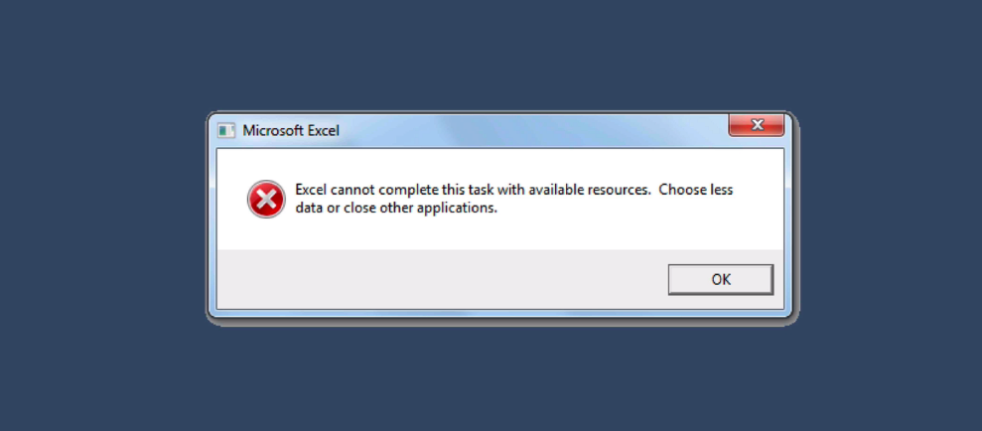
Data overflow error message in SQL

Slide 27
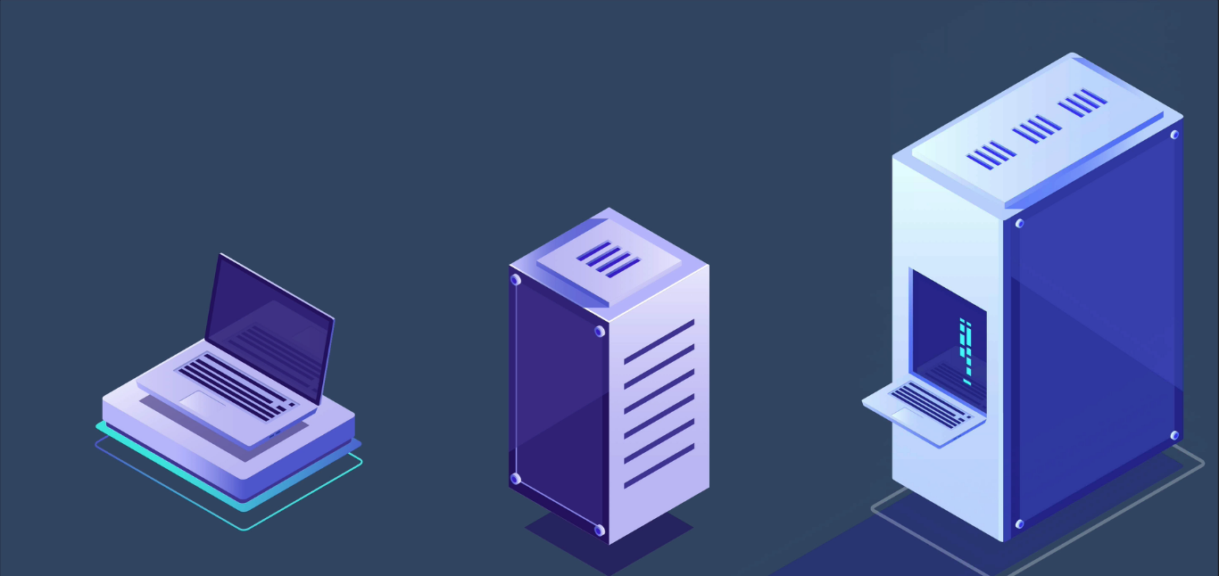
Now a days Storage of large information is important

Slide 28

Example: Storage is vertical in SQL Data base

Slide 29

Example: Storage is horizontal in SQL Data base

Slide 30
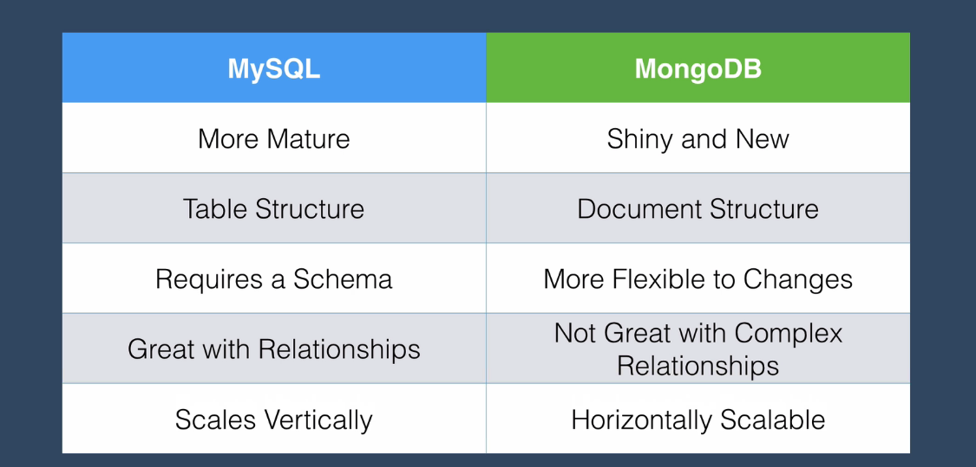
Difference between SQL and NO SQL

